Slide 1
Nebula Managed Workstation Service March 2015
Brian Arkills
Microsoft Solutions Architect
Windows Infrastructure Svc Mgr
Managed Workstation Svc Mgr
UW-IT, Identity and Access Management
Microsoft Directory Services MVP 2012-2014

Slide 2
New Capabilities & Improvements
Nebula-Discuss
Auto-email-response stopped; confusing “We’re done” message when we weren’t done is now gone.
Minor billing process change; recurring/non-recurring consequence should be gone soon
MyNebula -> MyIT + various improvements

Slide 3
Spotlights
Nebula-announce list
Corrupt Outlook profile workaround published, more self-help docs coming …
Nebula2 -> Netid user account conversion
UW-IT department conversion right now
Goal: you volunteer in next 6 months to be converted
+6mo: we’ll give unconverted accounts a date they will be converted
There will be sunset date in ~ 6 months

Slide 4
Spotlights continued
Anticipated FY16 Nebula Desktop core changes
Hope for a small rate reduction that reflects costs
Separate file services from core -> charge file svcs based on use
This probably means you:
Want to review who in your department has a nebula account and home directory. Ask us to remove those who are no longer valid.
Want to review your department’s current file storage use. If you are the dept contact, use https://support.nebula.washington.edu/myIT/fileServices.aspx.
May want to move some files to no-cost solutions like Google Drive or OneDrive for Business

Slide 5
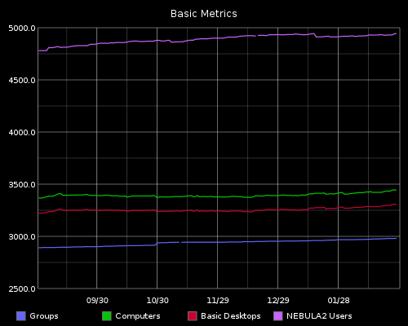
Trends: Basic counts

Slide 6
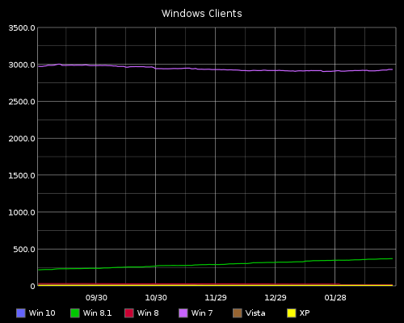
Trends: OS counts

Slide 7
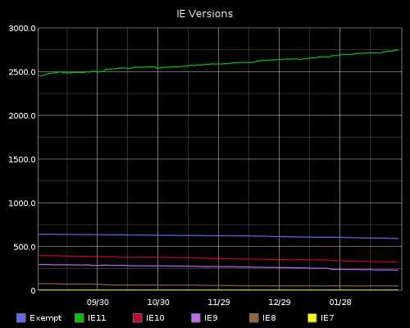
Trends: IE version counts

Slide 8
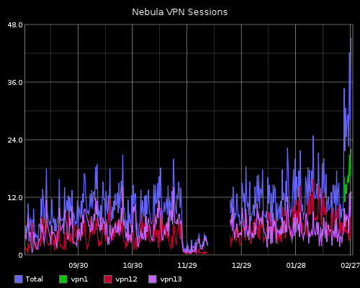
Trends: VPN session counts

Slide 9
What’s Next
FY16 bundle changes
Nebula2 user transition
Mac VPN design changes
Publish more self-svc documentation
UW Connect billing for consulting
Software Deployment infra refresh
Windows 10. Self-svc upgrade in place?
Data encryption for risk mitigation pilot (Azure RMS)

Slide 10
Questions? Unmet Business Needs?

Slide 11
The End
Brian Arkills
barkills@uw.edu
@barkills
http://blogs.uw.edu/barkills
http://www.netid.washington.edu
Author of LDAP Directories Explained

